Slide 1
Credit One
Moving to a More Predictable Customer-Base

Slide 2
Presentation Outline
Business Objectives
Data Science Approach
Our Process, In Detail
Data Sources
Managing the Data
Data Issues
Our Process, In Detail
Initial Insights

Slide 3
Business Objectives
Determine the customer characteristics that lead to default.
Predict the likelihood of customer default.
Reduce the incidence of Credit One customer default.
Notes:
Lower the risk of Credit One losing business as a result of customer defaults.
Put in place methods to prevent fewer Credit One customers from defaulting on loans.
Examine current customer demographics
Identify what customer traits relate significantly to customer default rates
Build a predictive model that Credit One can use to better classify potential customers as “at risk”

Slide 4
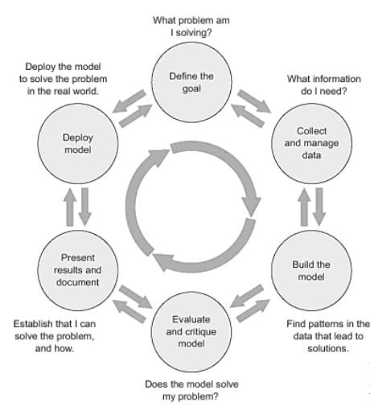
Data Science Approach
This image, from Practical Data Science with R, shows the approach or process that we will be using to assist Credit One in achieving their objective of identifying customers more likely to default.

Slide 5
Our process, in detail
(1) Frame the problem:
Who is your client? What exactly is the client asking you to solve? How can you translate their ambiguous request into a concrete, well-defined problem?
(2) Collect the raw data needed to solve the problem:
Is this data already available? If so, what parts of the data are useful? If not, what more data do you need? What kind of resources (time, money, infrastructure) would it take to collect this data in a usable form?
(3) Process the data (data wrangling):
Real, raw data is rarely usable out of the box. There are errors in data collection, corrupt records, missing values and many other challenges you will have to manage. You will first need to clean the data to convert it to a form that you can further analyze.

Slide 6
Our process, in detail (cont.)
(4) Explore the data:
Once you have cleaned the data, you have to understand the information contained within at a high level. What kinds of obvious trends or correlations do you see in the data? What are the high-level characteristics and are any of them more significant than others?
(5) Perform in-depth analysis (machine learning, statistical models, algorithms):
This step is usually the meat of your project, where you apply all the cutting-edge machinery of data analysis to unearth high-value insights and predictions.
(6) Communicate results of the analysis:
All the analysis and technical results that you come up with are of little value unless you can explain to your stakeholders what they mean, in a way that’s comprehensible and compelling. Data storytelling is a critical and underrated skill that you will build and use here.
Raj Bandyopadhyay

Slide 7
Data sources
Data Source: default of credit card clients.csv
Observations: 30,000
Features
5 demographic features:
Amount of Given Credit
Gender
Education
Marital status
Age (year)
6 months of payment history

Slide 8
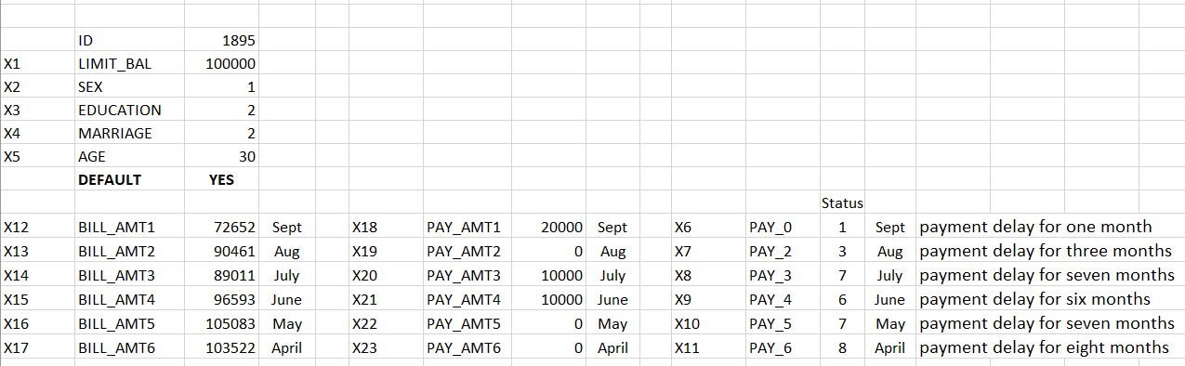
Data issues initial questions to address
Limited (6 Month) Payment History
Negative Bill Amounts – negative values need to be defined and possibly removed from the dataset
Inconsistent data definitions appear as invalid data
Example: ID 1895 – despite a payment delay for 6 mo status, the data shows a payment of

Slide 9
Data issues possible issues to identify and resolve, if necessary
Is each variable one column?
Is each observation one row?
Do different data types appear in each table?
Are there any miscoding of variables?
Does the dataset contain missing data?
Does the data show any outliers?
Does the data need to be normalized/standardized?
Do any textual features need cleaning?
Do we need to construct new features?
Do we need to reduce the dataset?
Do any data features need to be decomposed?
Does any data need to be discretized?

Slide 10
Managing the Data how will we assist credit one in terms of data management?
Area | Data Management Tasks
Data Engineering | • Identification and prioritization of new data sources • Automatic, self-integration of new sources of data • Integration and enrichment of data • Automatic index identification • Auto-map, cleanse, and standardize from sources to target
Data Preparation | • Analysis of suitability of various data structures • Determination of granularity/ aggregation strategies • Data quality rules, automatic data cleansing, exception handling • Anomaly detection and notification • Missing value imputation • Automatic variable creation and value binning • Topic modeling/ entity discovery (used in master data management and data governance)

Slide 11
Managing the Data (cont.) how will we assist credit one in terms of data management?
Area | Data Management Tasks, Moving Forward
Data Use | • Exploratory data analysis data prep and loading • Feature engineering and feature selection • Model management and evaluation • Suggest data sets, transforms, and rules
Data Operations and Security | • Self-healing mechanisms to handle changes to environments (e.g., upstream system changes) • Proactive estimates of data volumes, growth, and processing times for predictive data operations management • Prioritize data quality issues • Recommendations for data retention • Access security and auditing alerts

Slide 12
Initial insights
The dataset that we have been provided, certainly includes enough observations with which to develop a model. However, the quality of the data in the given dataset is still in question. Our analysts have raised multiple questions about the data regarding definitions and relationships within the dataset. We hope to have these questions addressed by persons at Credit One who have a more detailed understanding of the data. Regardless, we will continue to analyze and engineer the dataset we have been given and will move forward with the project.

